Slide 1
Bank Account System
Group4:Felix Faker Dante Bro Aba Tami

Slide 2
Name: Felix
ID: 201810701580052
Class: net182
Group: 4

Slide 3
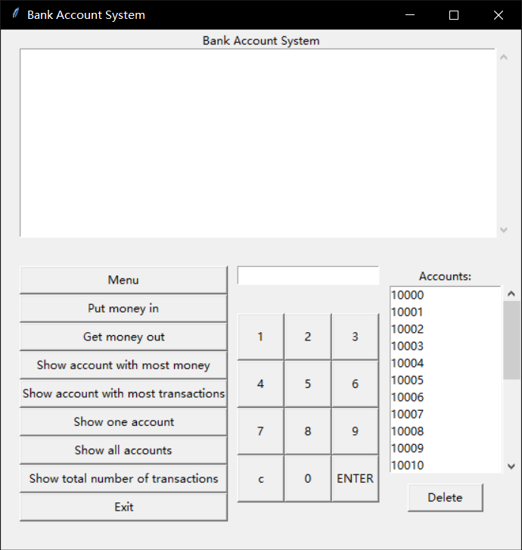
This is my part

Slide 4
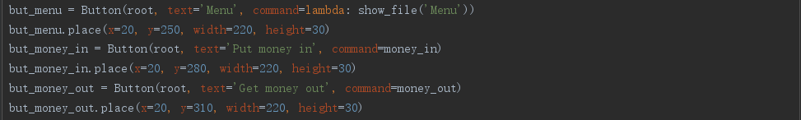
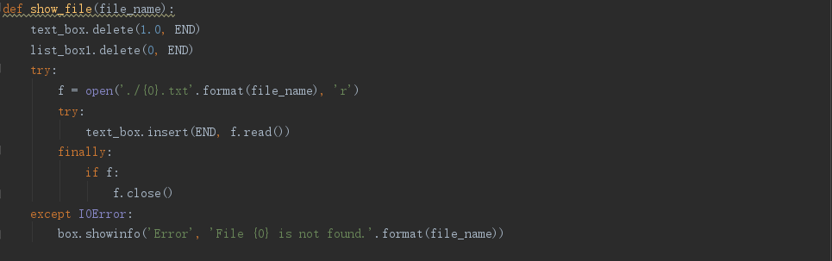

Slide 5
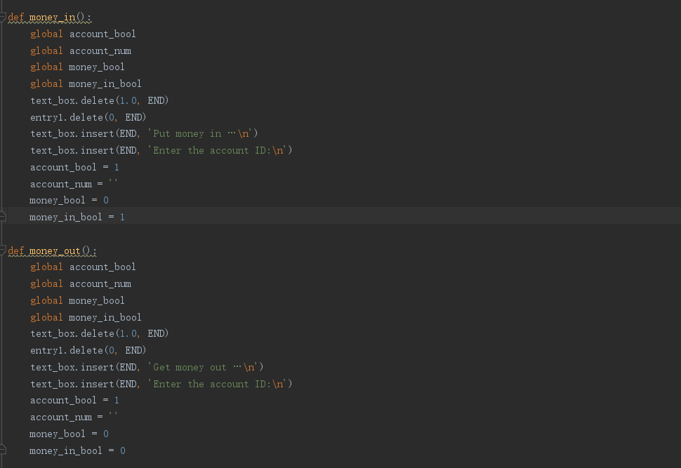

Slide 6
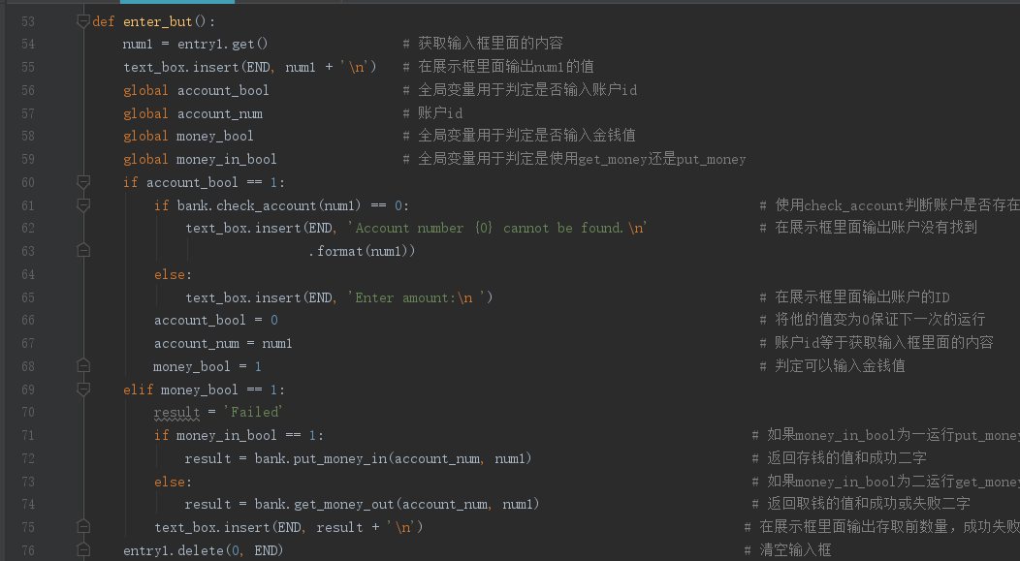

Slide 7
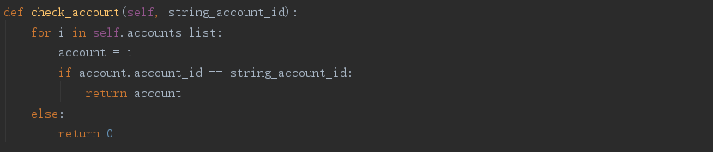
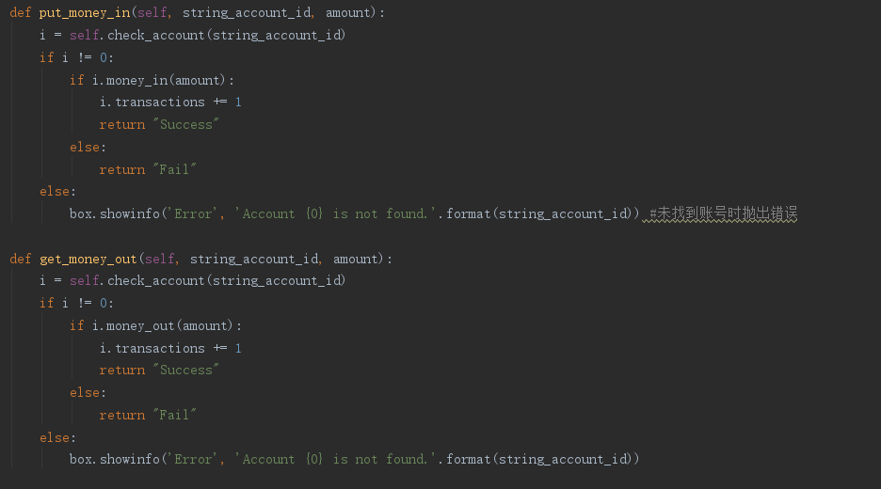

Slide 8
Name：Bro
Student ID：201810701580056
Class：Net182
Group：4

Slide 9
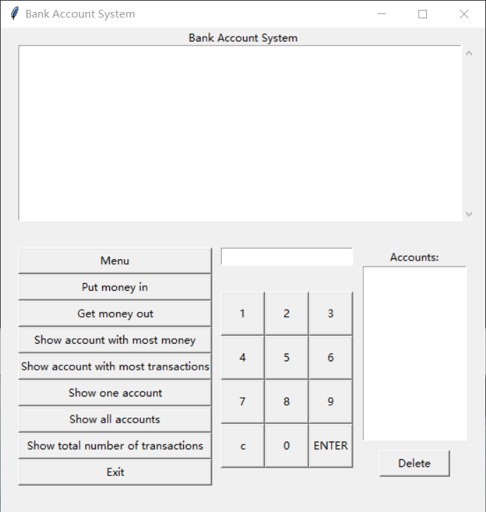
This is my part

Slide 10
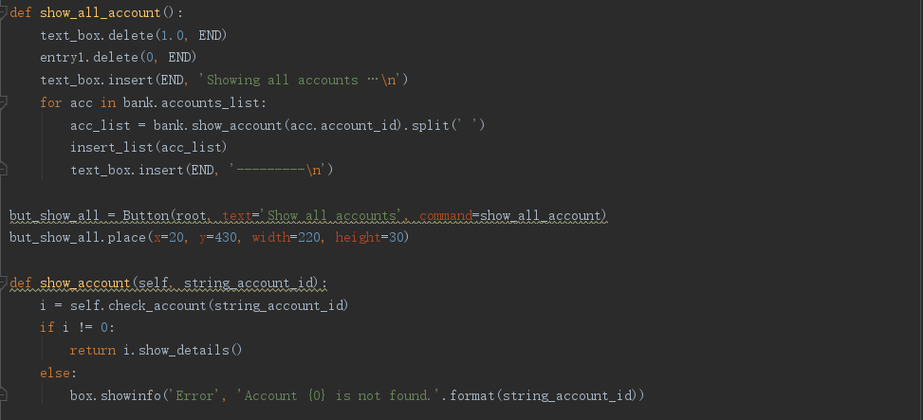
Button1

Slide 11
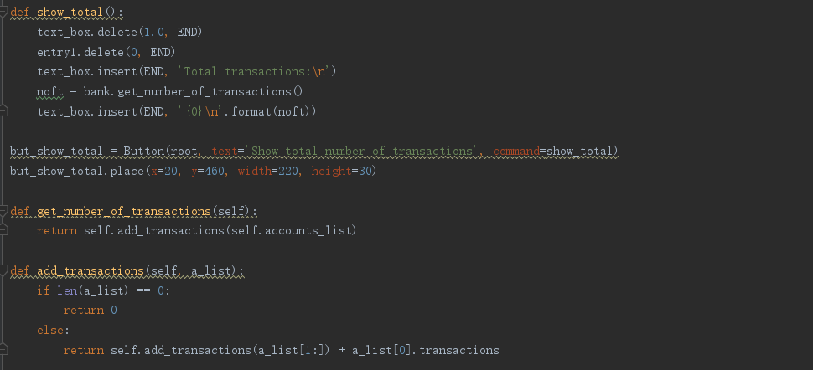
Button2

Slide 12
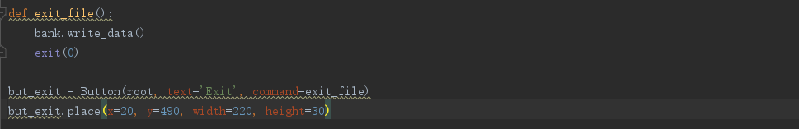
Button3

Slide 13
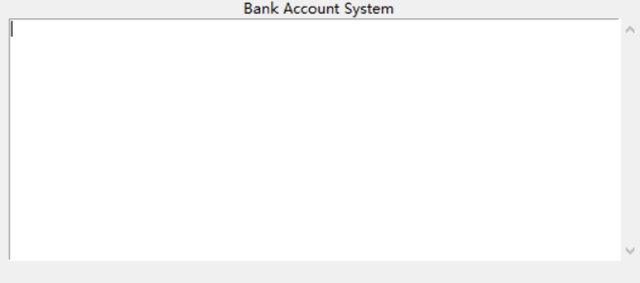
name: Aba class: net182 ID：201810701580046 group: 3

Slide 14
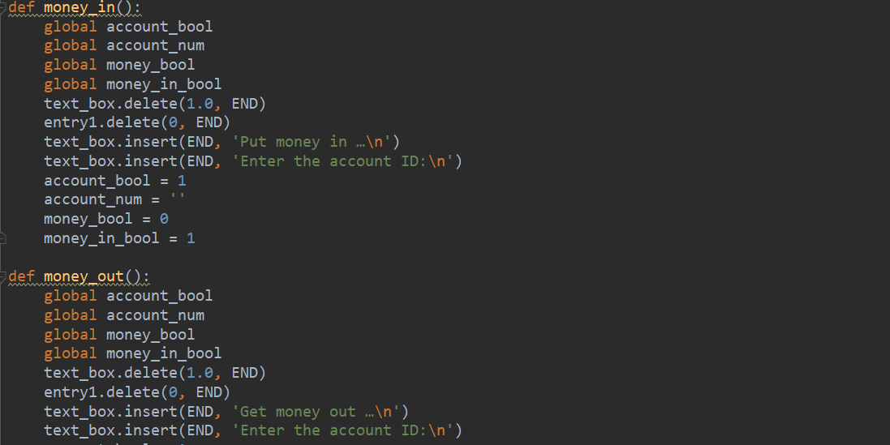

Slide 15
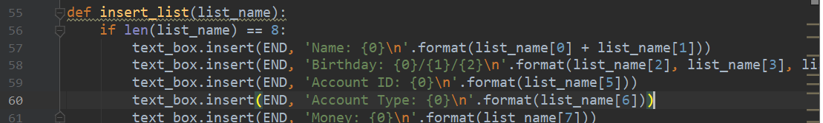

Slide 16
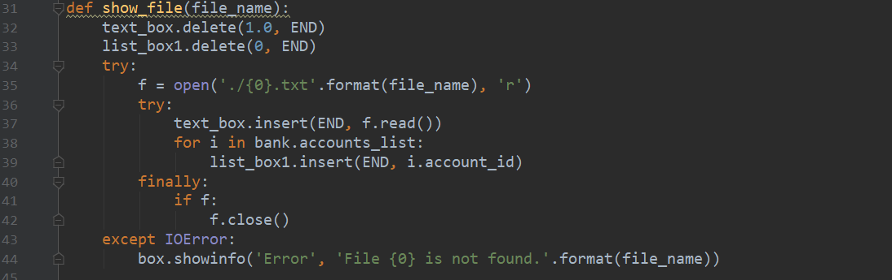

Slide 17
Name: Faker
ID: 201810701580034
Class: net182
Group: 4

Slide 18
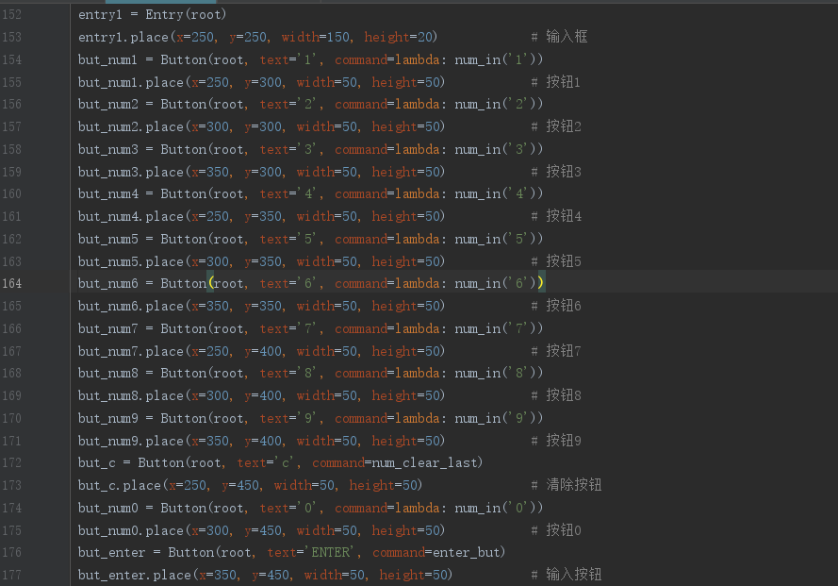
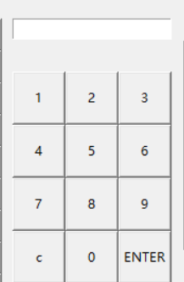
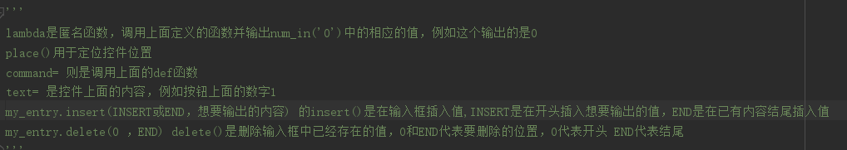

Slide 19
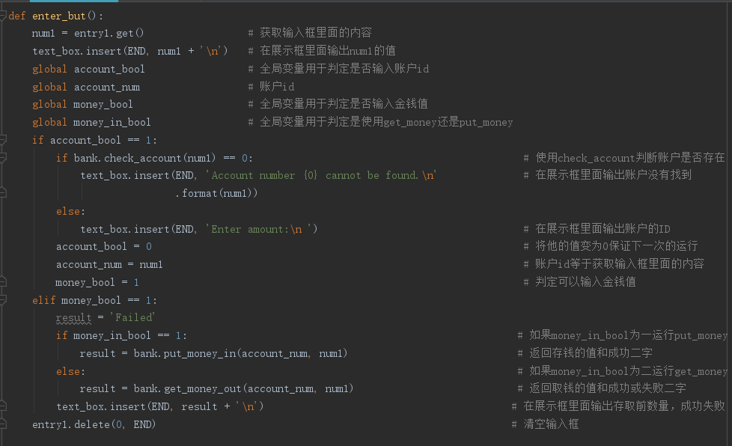

Slide 20
Name：Tami
Net：182
Id：201810701580035

Slide 21
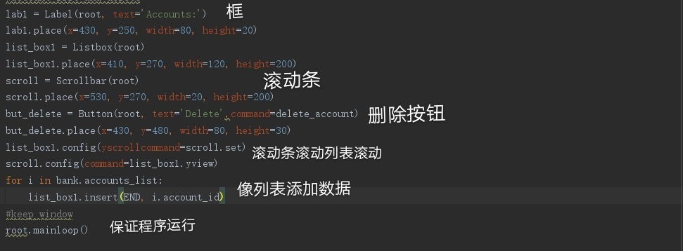
Label 框
滚动条
删除按钮
循环状态
appends the value in to the listbox

Slide 22
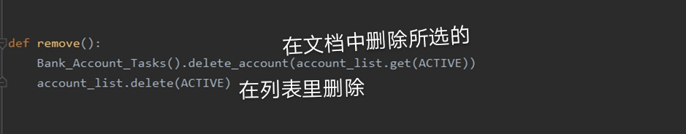

Slide 23
Name：Dante
Id：201810701580051
Class：Net182
Group：4

Slide 24
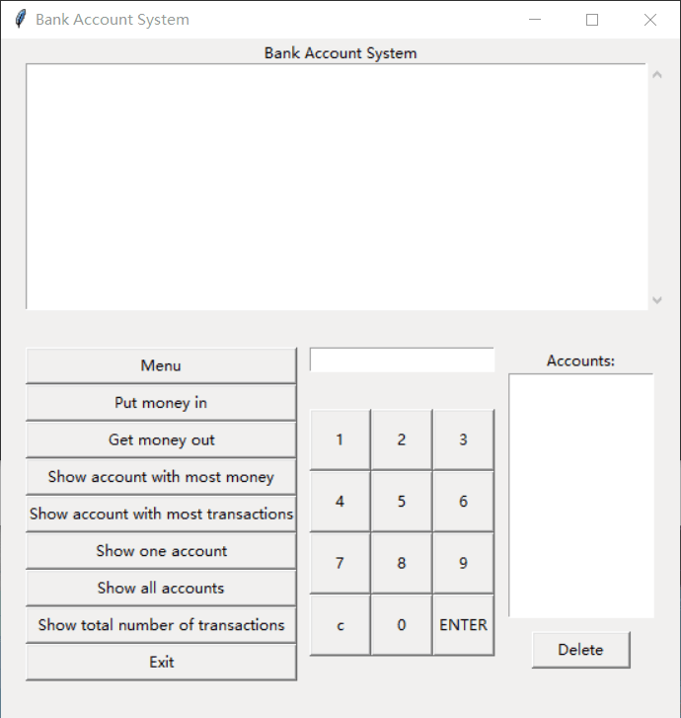
Three
Buttons
button1
button2
button3

Slide 25
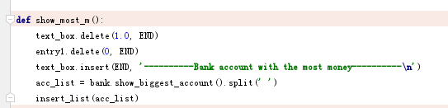
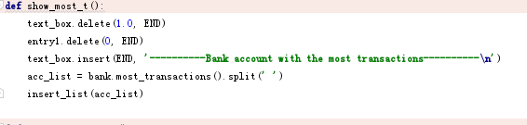
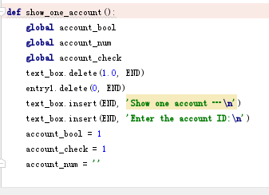

Slide 26
Button 1
def show_most_m():
text_box.delete(1.0, END)
entry1.delete(0, END)
text_box.insert(END, '----------Bank account with the most money----------\n')
acc_list = bank.show_biggest_account().split(' ')
insert_list(acc_list)
def show_biggest_account(self):
num = 0
maxnum = self.accounts_list[0]
for i in self.accounts_list:
if float(i.money) > num:
num = float(i.money)
maxnum = i
return maxnum.show_details()

Slide 27
Button2
def show_most_t():
text_box.delete(1.0, END)
entry1.delete(0, END)
text_box.insert(END, '----------Bank account with the most transactions----------\n')
acc_list = bank.most_transactions().split(' ')
insert_list(acc_list)
def most_transactions(self):
num = 0
maxnum = self.accounts_list[0]
for i in self.accounts_list:
if i.transactions > num:
num = i.transactions
maxnum = i
return maxnum.show_details()

Slide 28
Button3
def show_one_account():
global account_bool
global account_num
global account_check
text_box.delete(1.0, END)
entry1.delete(0, END)
text_box.insert(END, 'Show one account …\n')
text_box.insert(END, 'Enter the account ID:\n')
account_bool = 1
account_check = 1
account_num = ''

Slide 29
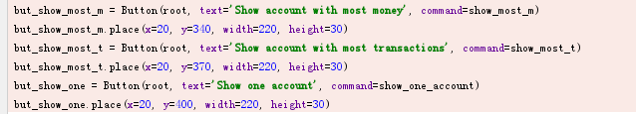
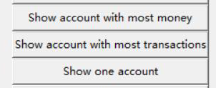
but_show_most_m = Button(root, text='Show account with most money', command=show_most_m)
but_show_most_m.place(x=20, y=340, width=220, height=30)
but_show_most_t = Button(root, text='Show account with most transactions', command=show_most_t)
but_show_most_t.place(x=20, y=370, width=220, height=30)
but_show_one = Button(root, text='Show one account', command=show_one_account)
but_show_one.place(x=20, y=400, width=220, height=30)

Slide 30
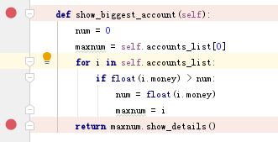
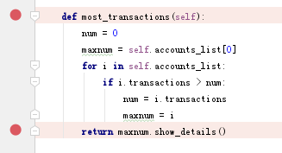

Slide 31
End

